Slide 1

SVKM’s Institute of Technology, Dhule Department of Information Technology
Major Project Presentation
On
“TALK TO ME: AN AI THERAPIST”
By
Dhanashri Saner 45
Gaurav Baviskar 05
Anuj Deshmukh 13
Darshan Sonar 49
Guide
“Prof. Sagar Badjate
Day and Date of Review : Saturday, 6 April 2024

Slide 2
Project Details
Project Title : TALK TO ME: AN AI THERAPIST
Project Domain: Machine Learning
Project Group Members:
T2054491246014 Dhanashri Saner
T2054491246017 Gaurav Baviskar
T2054491246007 Anuj Deshmukh
T2054491246012 Darshan Sonar

Slide 3
Motivation
AI Therapist for depressed individuals address the scarcity of accessible mental health support. They provide immediate, confidential assistance, combating stigma and offering 24/7 availability. Customized interventions, early detection, and anonymity aid those reluctant to seek human counseling. By imparting coping strategies and fostering self-care, AI counselors enhance well-being and bridge gaps in traditional care.

Slide 4
Statistics for India Age and sex-specific incidence of depressive illnesses in India: NMHS findings

Slide 5
Problem statement
Depressed individuals often face a range of challenges that impact their well-being, daily functioning, and overall quality of life.
Due to inadequate accessibility and stigma surrounding mental health support individual suffers from many lows. Many face barriers such as limited availability, high costs, and fear of judgment, deterring them from seeking help..

Slide 6
AIM and OBJECTIVE
AIM:
The primary aim of this project is to reduce the impact of depression on individuals by providing personalised, immediate therapeutic support.
Objective:
Provide Emotional Support
Deliver Evidence-Based Information
Recognize and Respond to Emotional Cues

Slide 7
Abstract
This project develops an AI counsellor addressing depression's challenges through natural language processing, sentiment analysis, and machine learning. It offers immediate, private help, personalized coping, early distress detection, and emotional well-being promotion. Advancing tech-driven mental health support, it enhances access, reduces stigma, and improves depressed individuals' quality of life, measured by engagement, outcomes, and ethics.

Slide 8
Approach to solve the problem
User Input: Text, facial expressions, and voice inputs.
Input Analysis: Sentiment analysis for both facial and voice inputs.
External Resources: Utilize OpenAI API and question dataset to enhance response of the model.
Response Generation: Model 3D facial expressions and animations based on sentiment and contextual understanding.
Final Output: Generate a holistic response, including the 3D face reacting to user inputs and any additional information provided by the AI system.

Slide 9

Architecture Diagram:
OPEN AI
QUESTION DATASET
TEXT DATASET
INPUT
AI THERAPIST
RESPONSE
AR/VR 3D FACE
FACIAL, VOICE
PRORR
EXPRESSION MODELLING
CNN
SENTIMENT ANALYSIS
MODEL
DATASET
Processing
OUTPUT
FINAL OUTPUT
NLTK

Slide 10
Technology Stack
Language: Python
Frontend: HTML, CSS, Javascript
Backend: Flask
Deep Learning: CNN, NLP
Libraries: tensorflow, PyTorch, Speech recognition, NLTK
API’s: OpenAI API
3D face: AR/VR Model

Slide 11
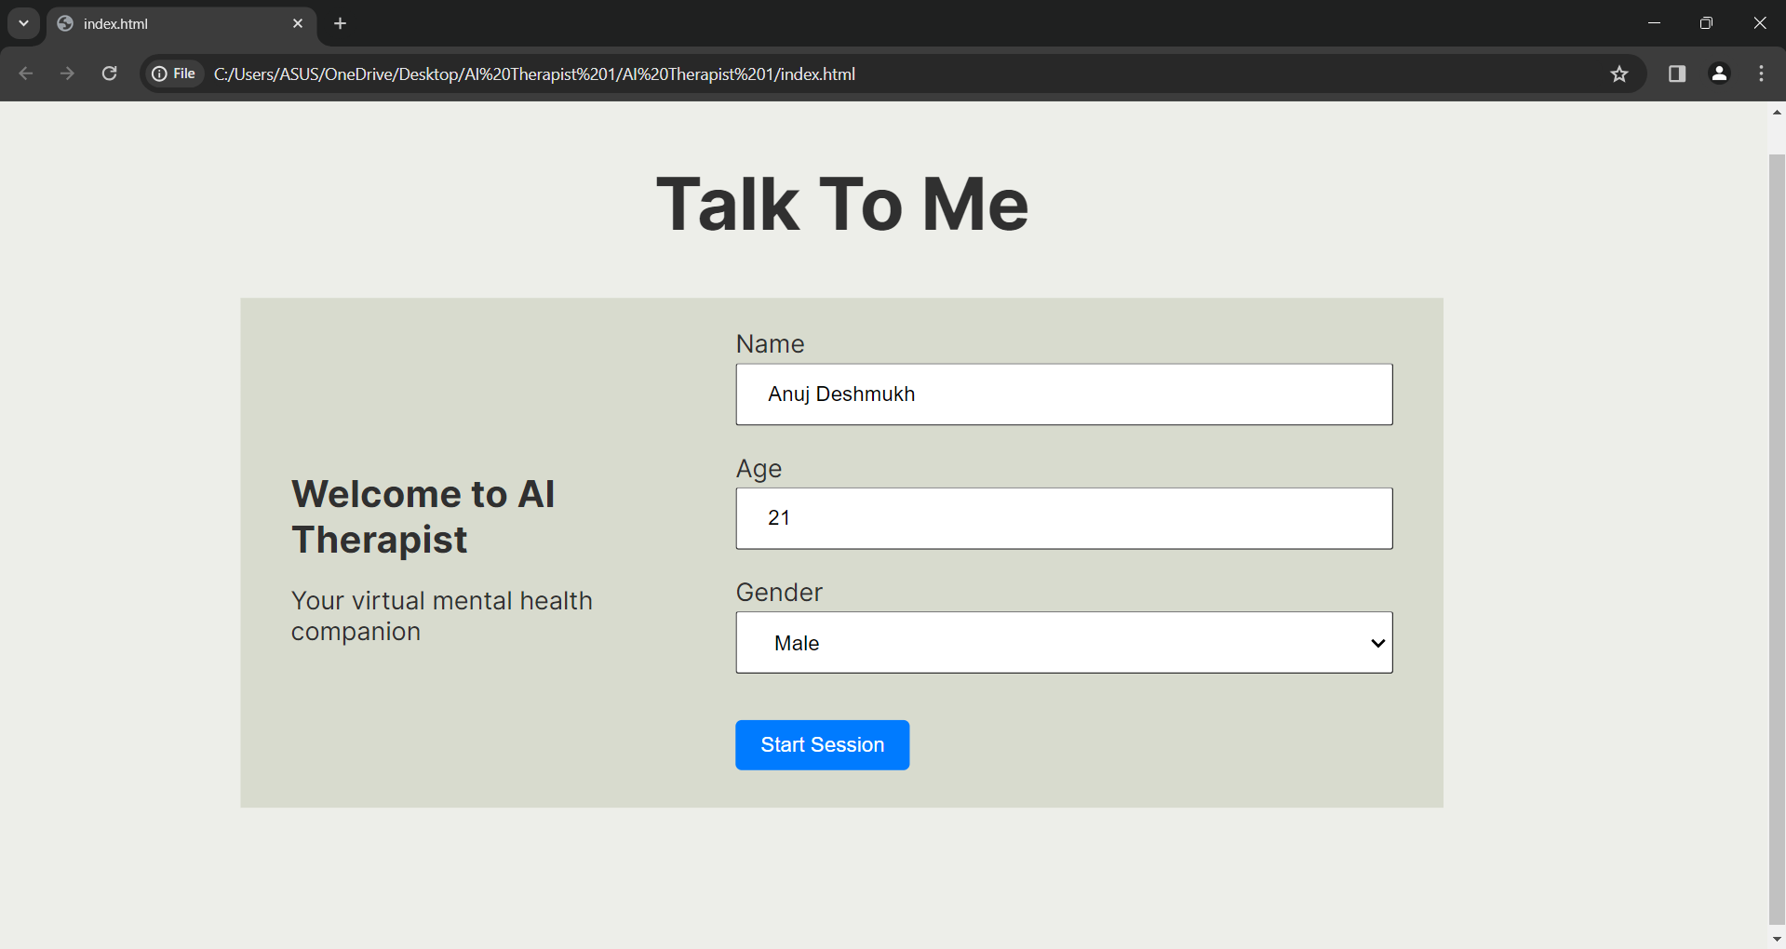
Results

Slide 12
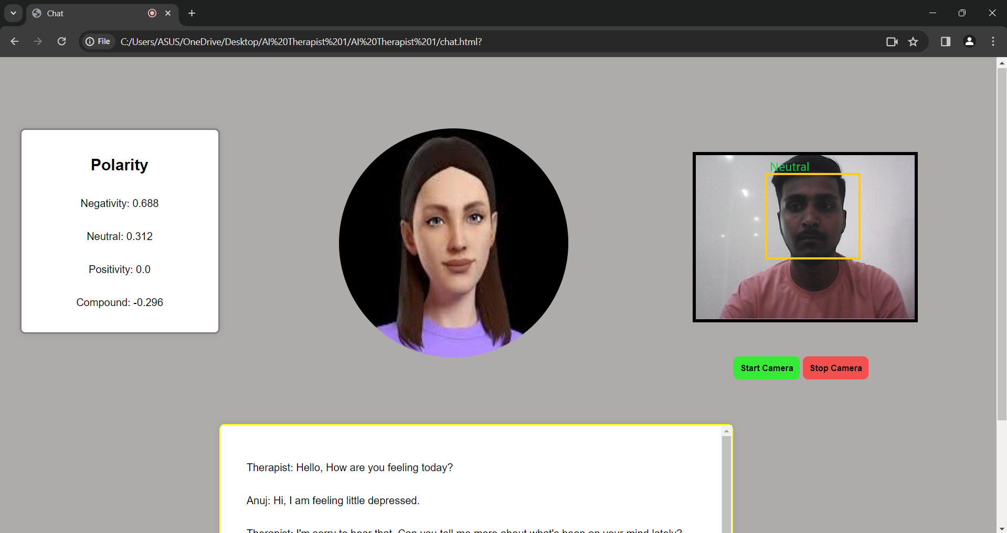

Slide 13
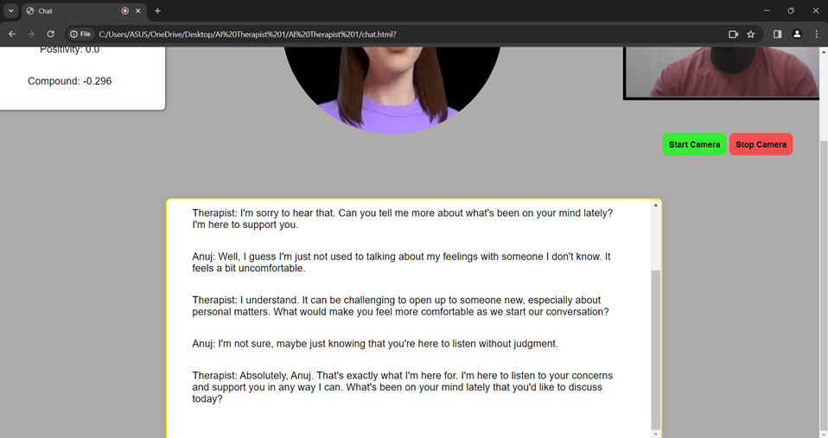

Slide 14
References
Victor Hung, Miguel Elvir, Avelino Gonzalez, Ronald DeMara, "Towards a Method For Evaluating Naturalness in Conversational Dialog Systems," 2009 International Conference on System, San Antonio, TX, USA, 2009
Tarashankar Rudra, Manning Li, Manolya Kavakli, "ESCAP: Towards the Design of an AI Architecture for a Virtual Counselor to Tackle Students’ Exam Stress," 2012 45th Hawaii International Conference on System Sciences, Australia, 2012
Carol Antony, Bestina Pariyath, Seema Safar, Aswin Sahil, Akash R Nair , “Emotion Recognition-Based Mental Healthcare Chat-bots: A Survey ,“ International Conference on IoT based Control Networks and Intelligent Systems (ICICNIS 2020) , Kochi 682039, Kerala, India, 2020.
Sushruth P Konapur, Tejas Krishna, Varun G, Uma R, Sarojadevi H, "Design of a Chatbot for People Under Distress using Transformer Model.," 2021 2nd Global Conference for Advancement in Technology (GCAT) | 978-1-6654-1836-2/21/$31.00 ©2021 IEEE, Bangalore, India. Oct 1-3, 2021
Bhuvan Sharma, Harshita Puri and Deepika Rawat, "Digital Psychiatry – Curbing Depression using Therapy Chatbot and Depression Analysis," Proceedings of the 2nd International Conference on Inventive Communication and Computational Technologies (ICICCT 2018) IEEE Xplore Compliant - Part Number: CFP18BAC-ART; ISBN:978-1-5386-1974-2

